Slide 1


Slide 2
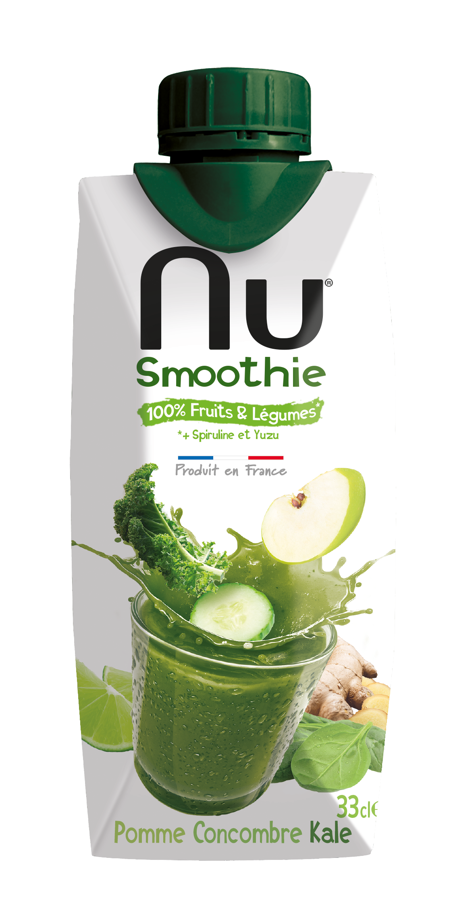
APPLE CUCUMBER KALE

Slide 3
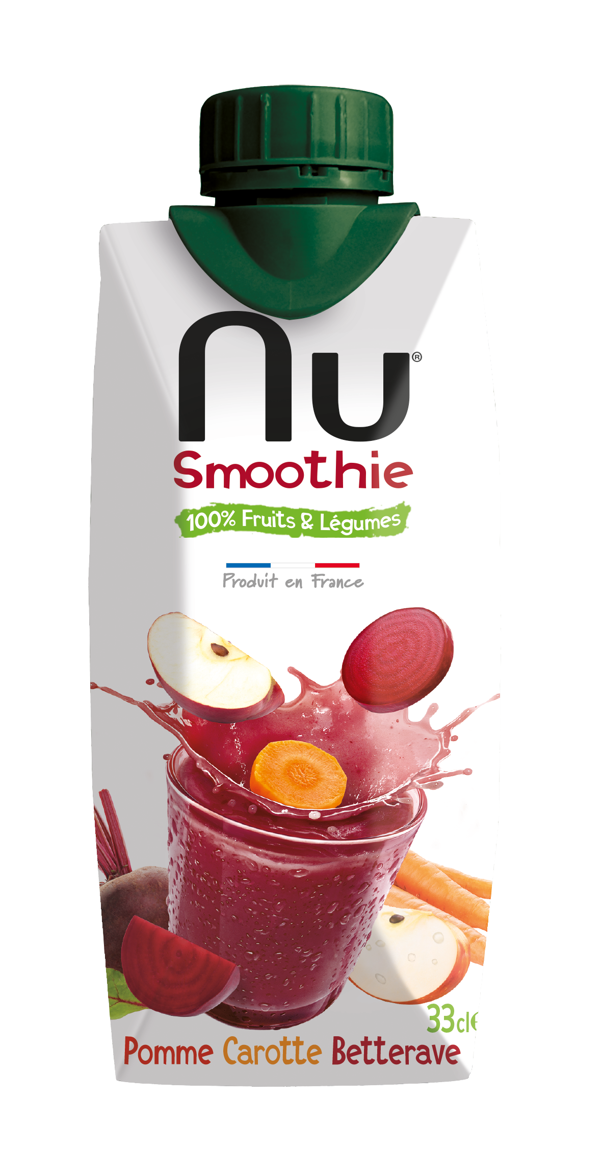
APPLE CARROT BEET

Slide 4

CARROT APPLE ORANGE

