Slide 2
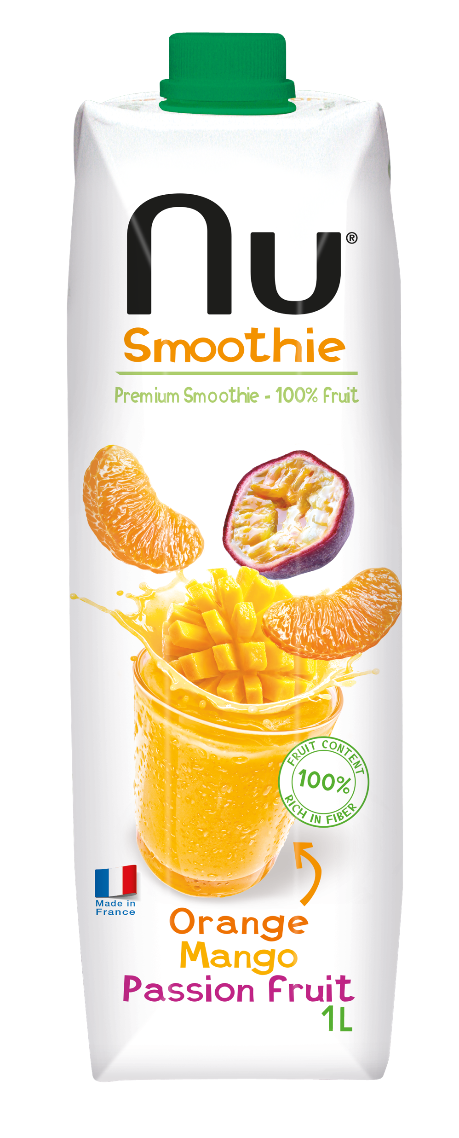
ORANGE MANGO PASSION FRUIT

Slide 3
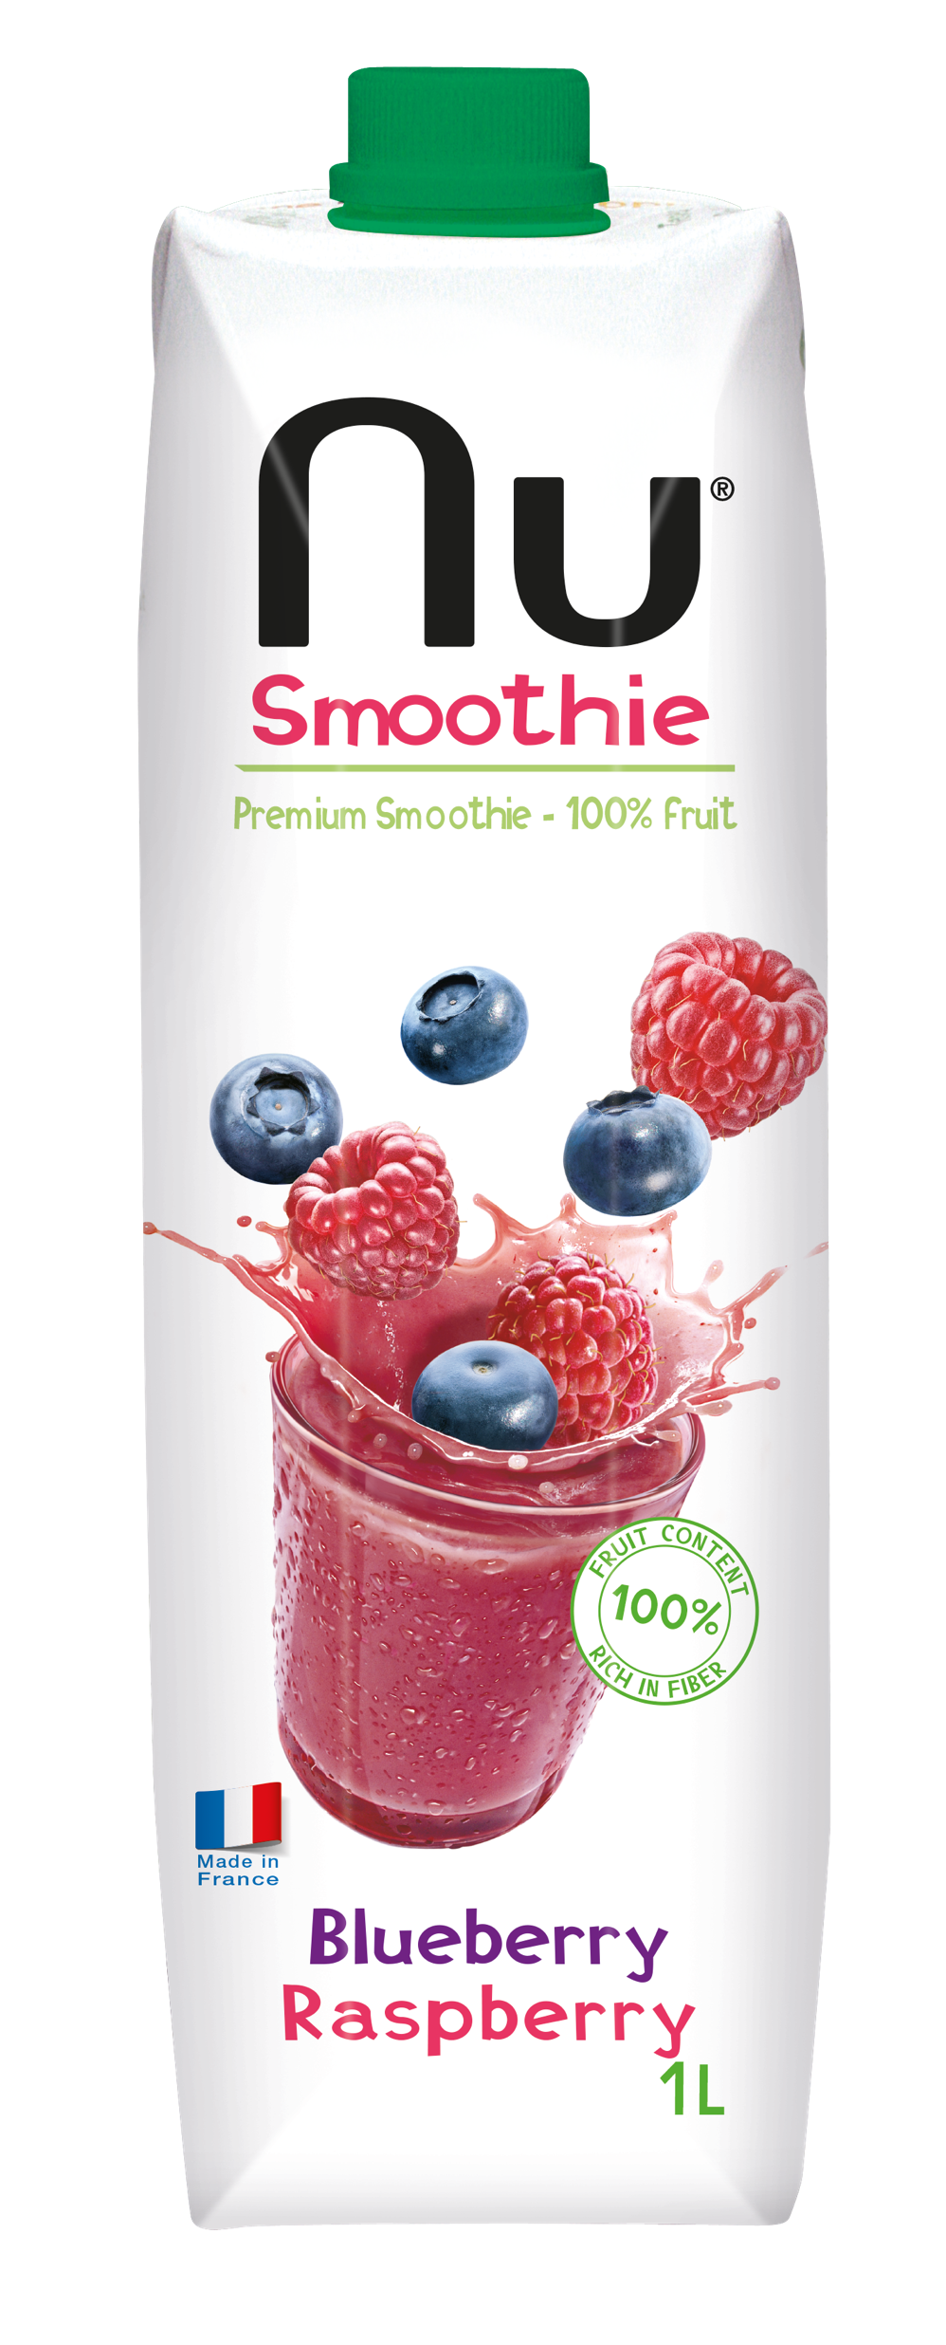
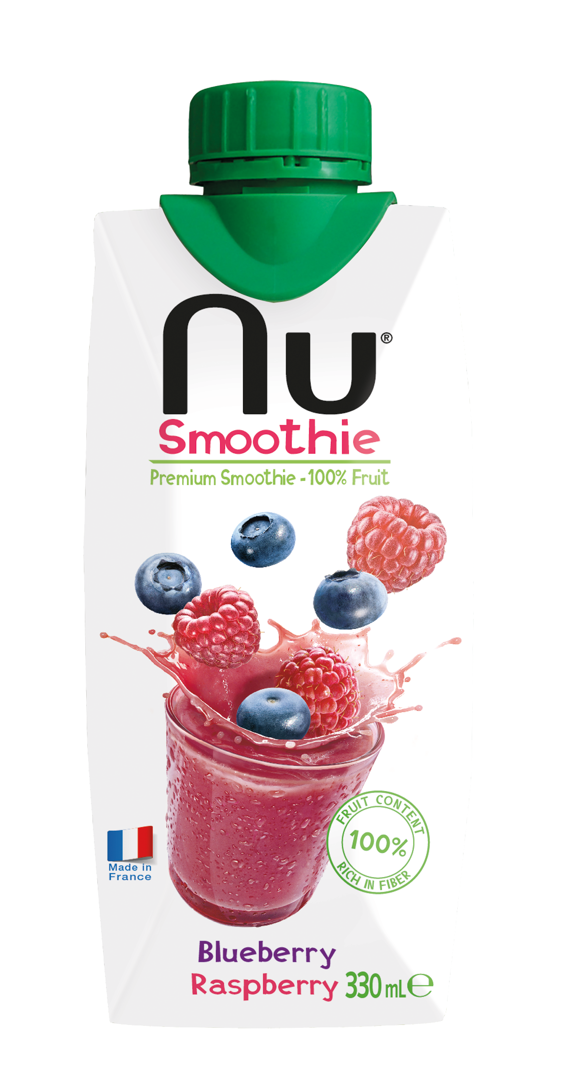
BLUEBERRY RASPBERRY

Slide 4
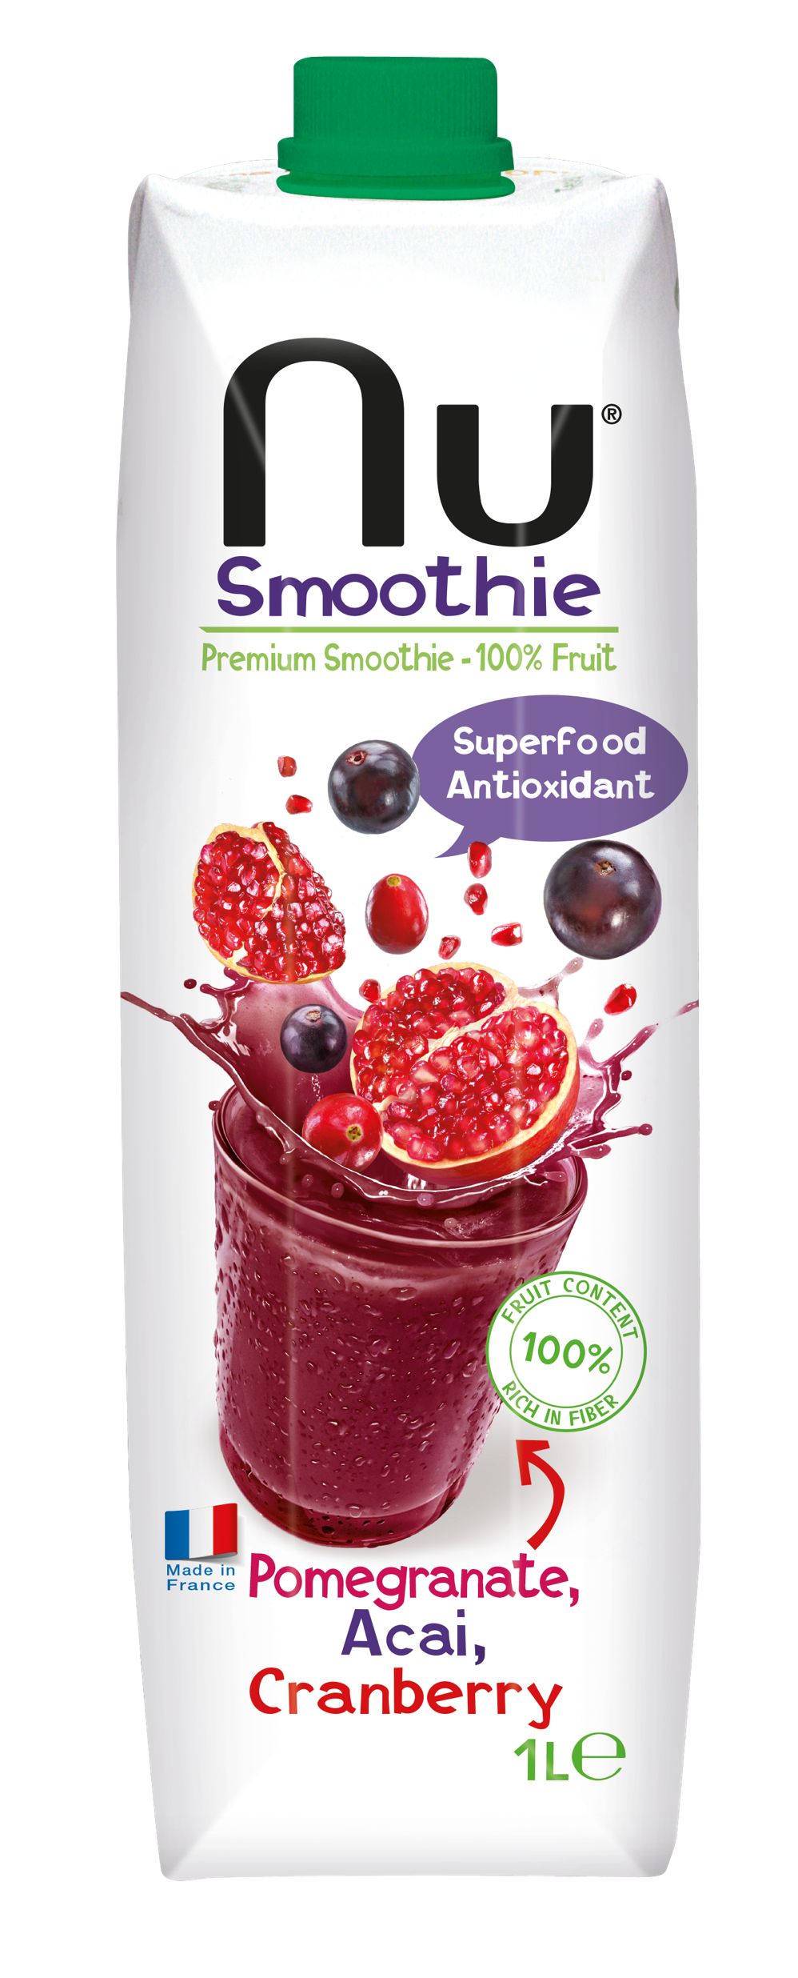
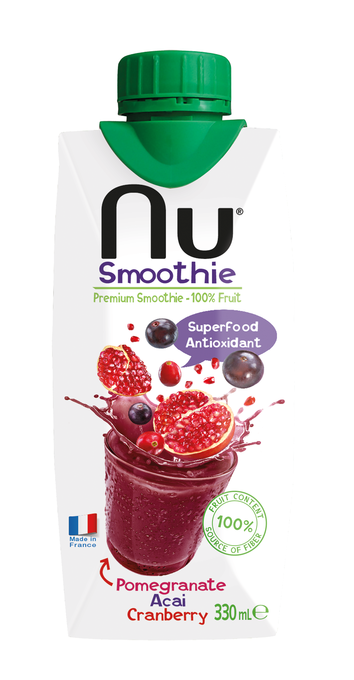
POMEGRANATE AÇAI CRANBERRY

Slide 5
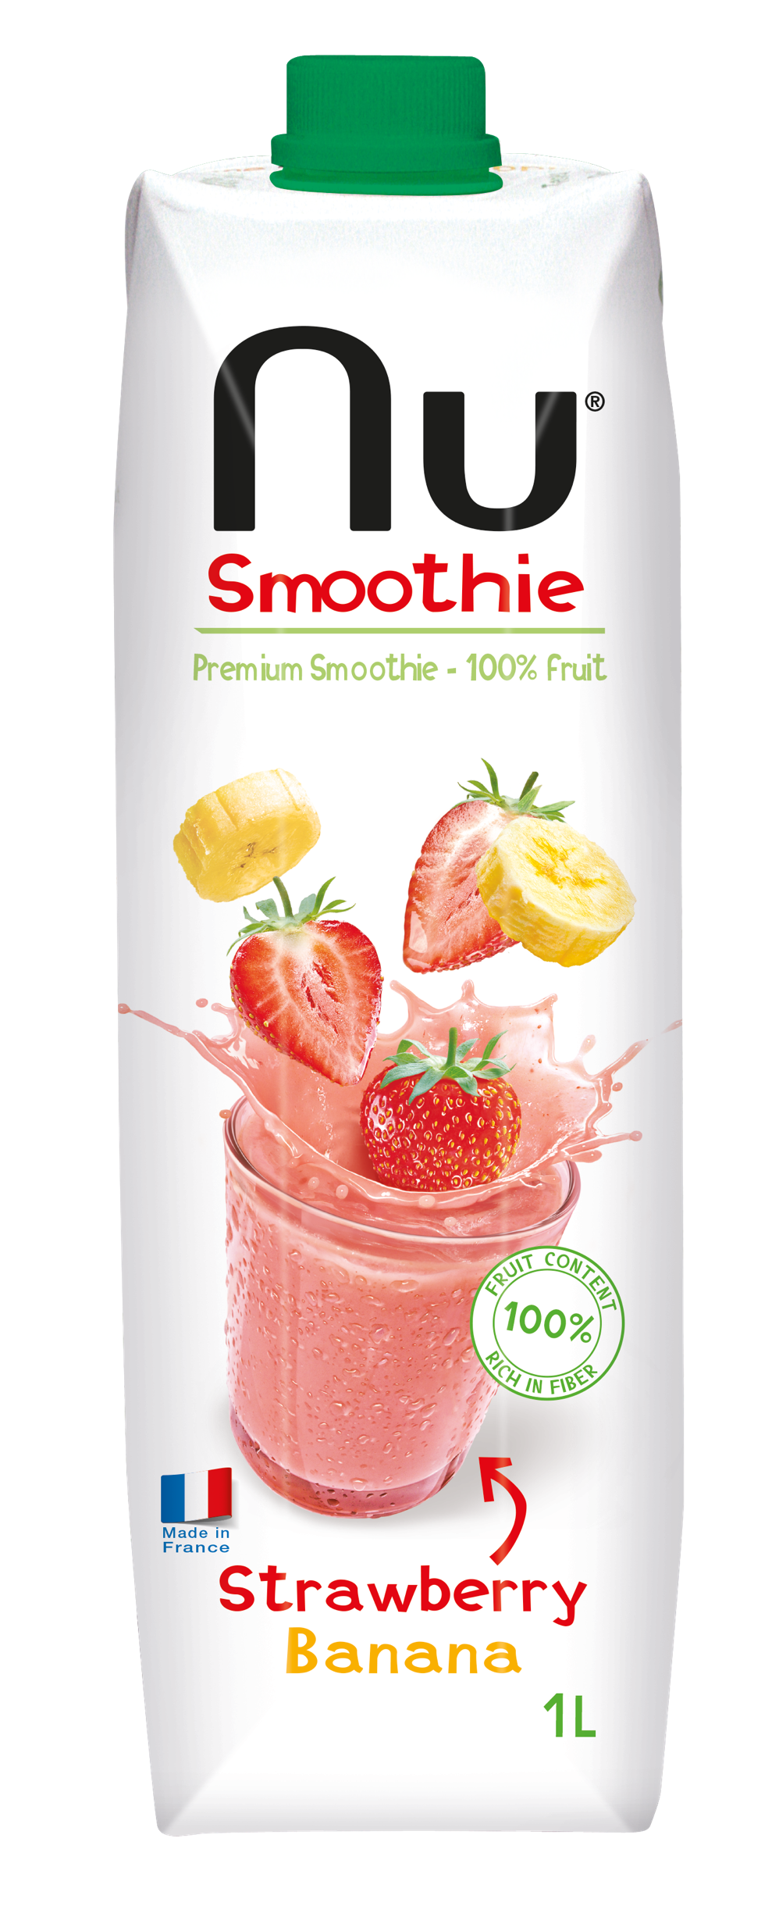
STRAWBERRY BANANA

Slide 6
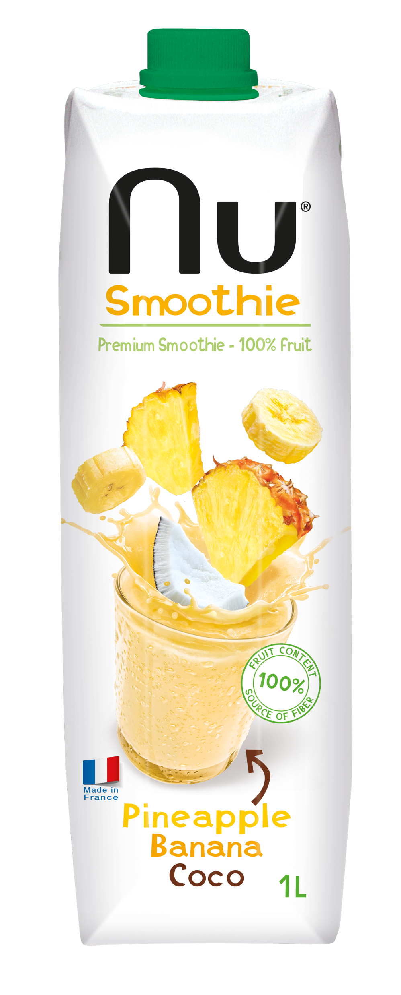
PINEAPPLE BANANA COCO

Slide 7
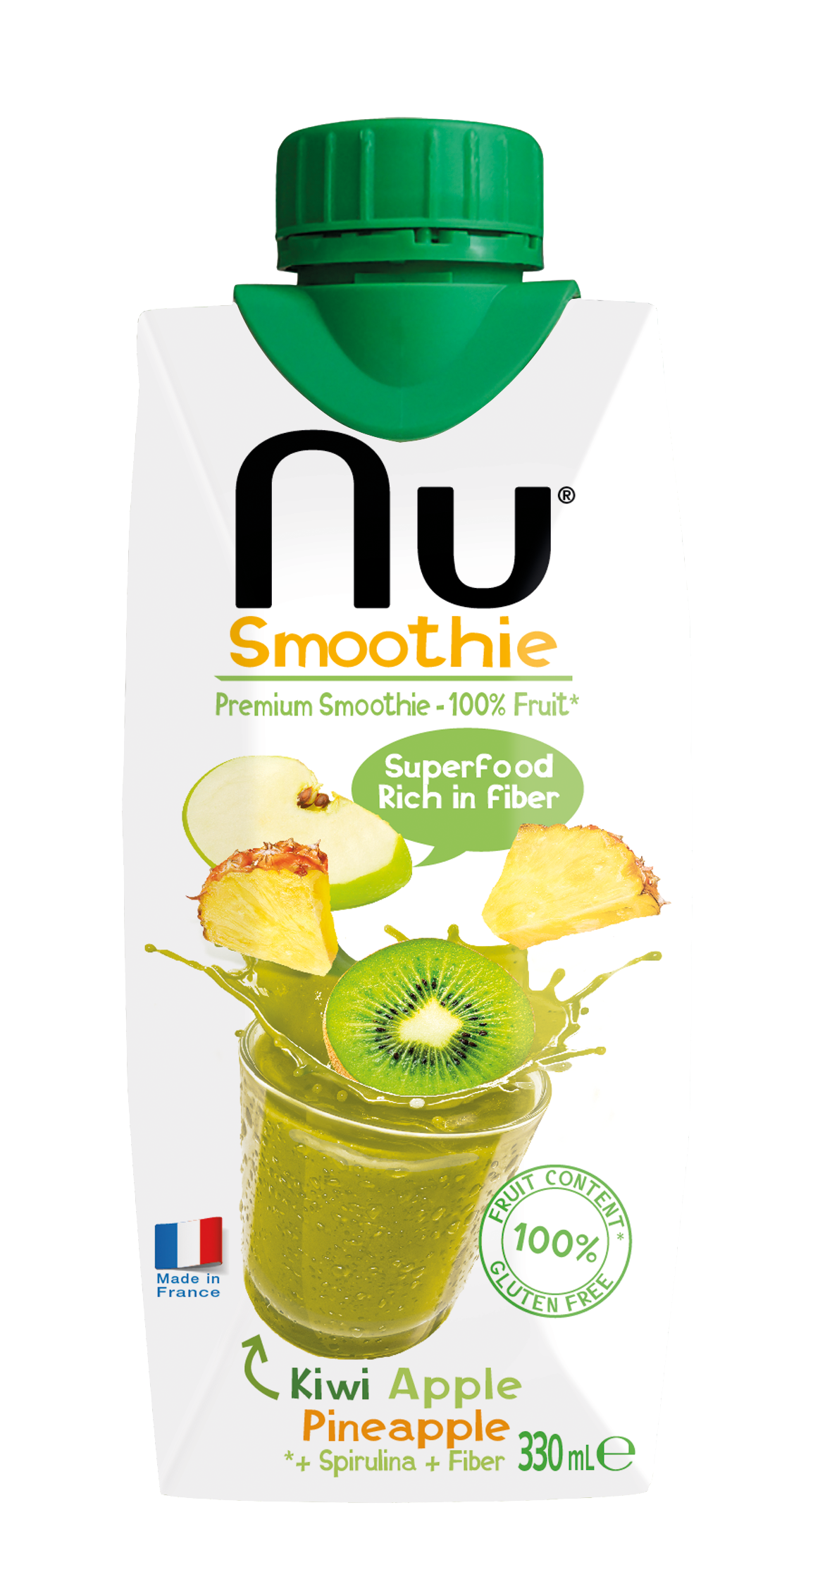
KIWI APPLE PINEAPPLE

